Slide 1

Pointer Calculator
Prepared By:
Mr. Kazi Jawwad A Rahim (T-16-0020)
Mr. Kiratkar Gunjan Narayan (T-16-0080)
Mr. Naik Aniket Anand (T-15-0287)
Guided By:
Prof. Santosh V. Jadhav

Slide 2
Contents
Introduction
Motive
Inspiration / Idea
Design
Working
Utility / Scope of project in the society
Future Scope

Slide 3
Introduction
Need of pointer calculator
SGPI
CGPI

Slide 4
Motive
Handheld application
Runnable across versions of android
Easiness for the students
Specifically for Engineering students

Slide 5
Inspiration / Idea
Need among Engineering Students
Websites used for pointer calculation
Updated standards for calculations
Don’t need to remember any formulae

Slide 6
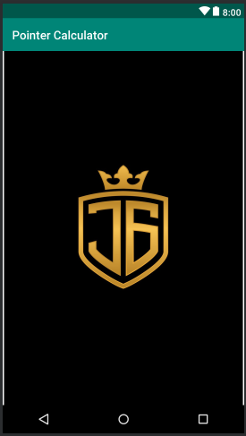
Design
Fig. Splash Screen

Slide 7
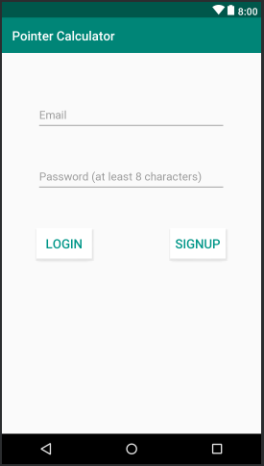
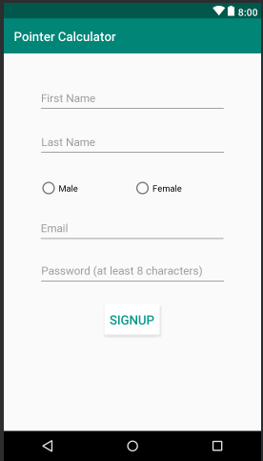
Login Activity Register Activity

Slide 8
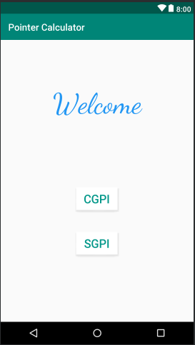
Main Activity

Slide 9
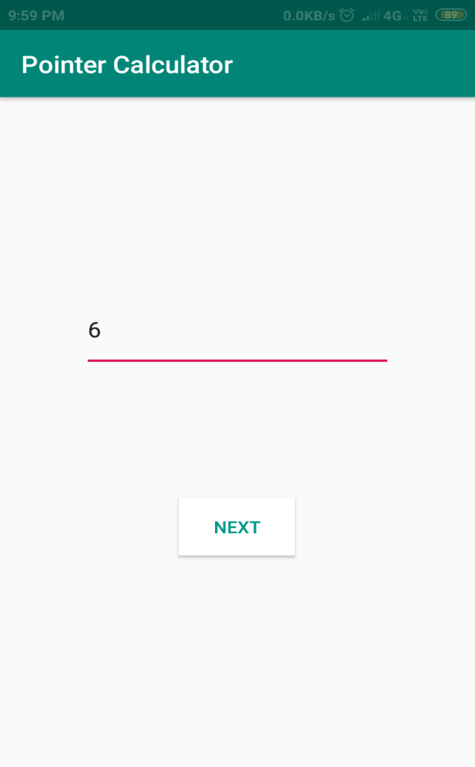
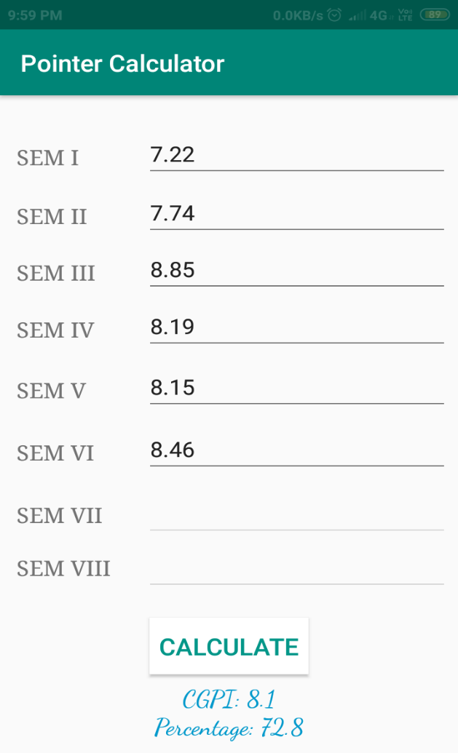
Semesters Activity CGPI Activity

Slide 10
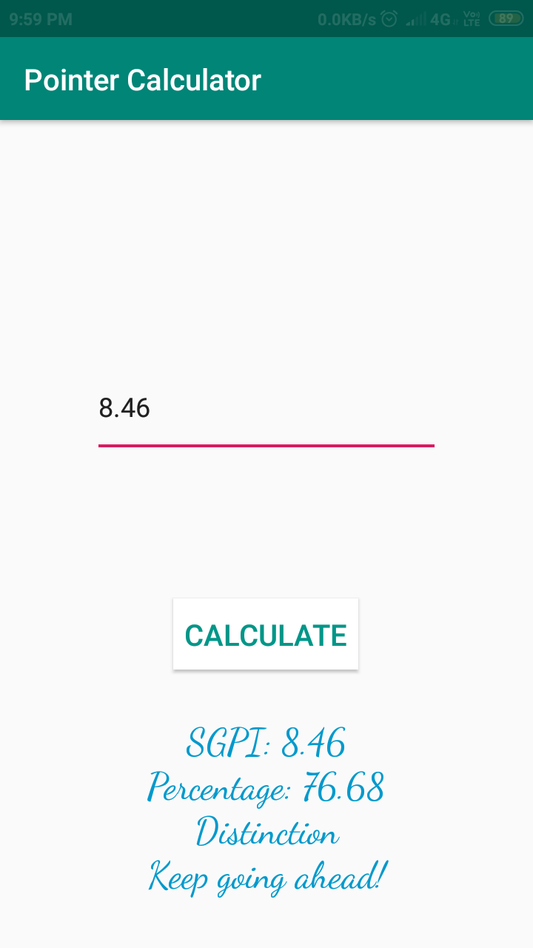
SGPI Activity

Slide 11
Working
User needs to Register in the application if already then can proceed with Login.
User have two options
When selects CGPI- It needs to enter No of semesters followed by pointer of each semester. On submit it gets average pointer along with corresponding percentage.
When selects SGPI- It needs to enter pointer to check its equivalent percentage as well as a motivational remark.

Slide 12
Utility / Scope of the project in the society
Helpful for Engineering students.
Not to worry about the calculations.
Uses inbuilt database.
Easy to use.
Runnable on various versions of Android.
Compact in size.

Slide 13
Future Scope
We would like to deploy it to Play Store.
We would like to modify code as per the Google Play standards (For security issues)
We would like to upgrade it as per the university norms for pointer calculation purpose.

Slide 14
Thank You !!!

